Slide 1
Aplastic Anemia
Professor of the Department internal diseases
Liskova Yu.V.

Slide 2
Hematopoietic Differentiation
Notes:
As the stem cell divides, one daughter cell must engage in self-renewal so as not to lead to stem cell exhaustion. Self-renewal is nurtured in special marrow niches where the stromal cells and secreted growth factors support and protect the hematopoietic stem cells.

Slide 3
Bone Marrow Failure

Slide 4
Bone Marrow Production
STEM CELL
COMMITTED CELL
MATURE CELL
OUTPUT
CIRCULATION

Slide 5
Symptoms: Result of Pancytopenia
Easy fatigability
Dyspnea on exertion
Chest tightness
Fever
bacterial and fungal infection
Stomatitis, sinusitis, cellulitis
Petechiae and ecchymoses
Epistaxis, conjunctival and gingival bleeding

Slide 6
The Hypocellular Marrow

Slide 7
BM Aspiration
BM Biopsy

Slide 8
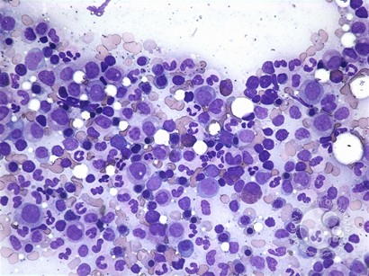
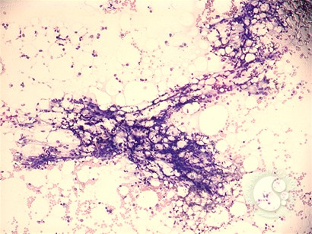
Aplastic Marrow Aspirate
Normal marrow

Slide 9
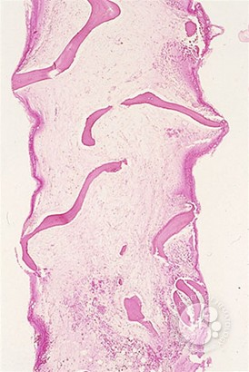
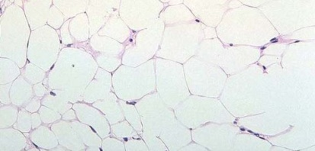
Hypocellular marrow
Bone marrow biopsy
<5% cellular

Slide 10
Aplastic Anemia (AA)
The term AA is first used by Ehrlich in 1888
Describes a disorder of unknown etiology characterized by
pancytopenia with
hypo or acellular bone marrow.
It is one of the stem cell disorders.

Slide 11
Classification of AA
I-Inherited AA
Dyskeratosis congenita
Skin, nail and hair abnormalities
Telangiectasia
Alopecia
Abnormal sweating
Mental retardation
Growth failure and hypogonadism
Shwachman–Diamond syndrome
Fanconi’s anemia:
Autosomal. recessive inheritance
Skeletal and renal defects
Hyperpigmentation
Small stature
Hypogonadism
Chromosomal changes
Familial AA (non-Fanconi)
Familial but without features of Fanconi’s anemia

Slide 12
Somatic abnormalities in Fanconi’s anemia
Abnormality % of patients
Skeletal (radial , hip, vertebral, scoliosis, rib) 71
Skin pigmentation (café-au-lait, hyper- and hypopigmentation) 64
Short stature 63
Eyes (microphthalmia) 38
Renal and urinary tract 34
Male genital 20
Mental retardation 16
Gastrointestinal (e.g. anorectal, duodenal atresia) 14
Heart 13
Hearing 11
Central nervous system (e.g. hydrocephalus) 8
No abnormalities 30
Notes:
The most common anomalies

Slide 13
Fanconi’s anemia
Occurrence of Pancytopenia: Age 7(med) 90% up to age 40
Leukemia & other malignancy
hepatic
squamous cell carcinomas of the
vulva, oesophagus,head and neck
Important:
Chromosomal breakage and hypersensitivity to the clastogenic effect of DNA cross-linking agents
diepoxybutane (DEB) and mitomycin C (MMC)

Slide 14
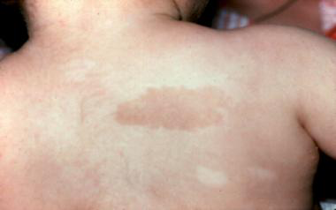
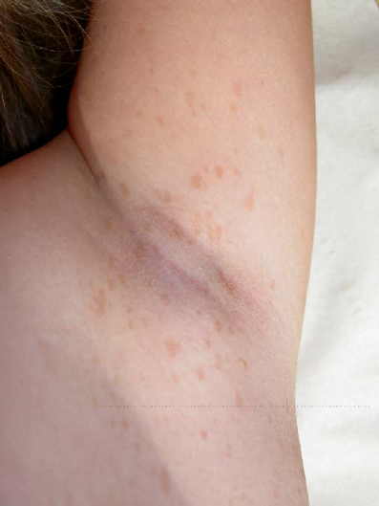
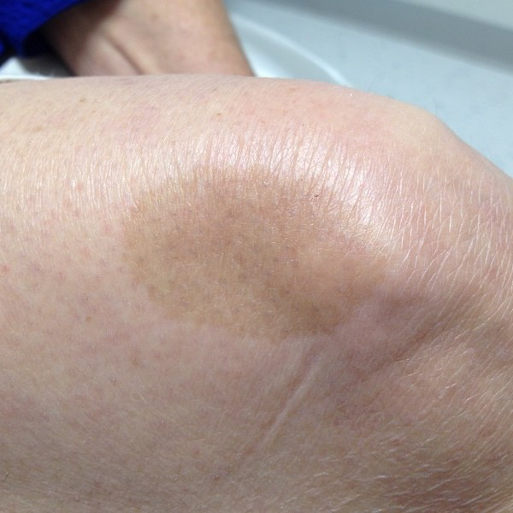
Abnormal skin pigmentation

Slide 15
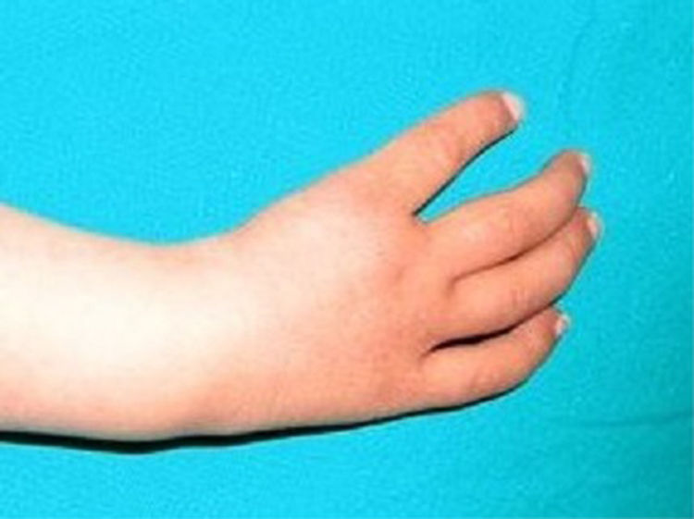
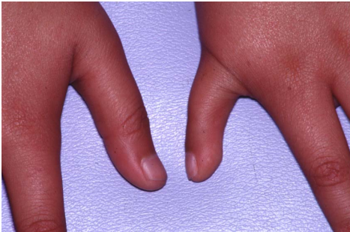
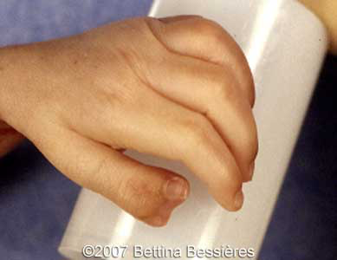
Bone-thumb abnormalities seen with Fanconi’s anemia
Notes:
Bone-thumb abnormalities seen with Fanconi’s anemia

Slide 16
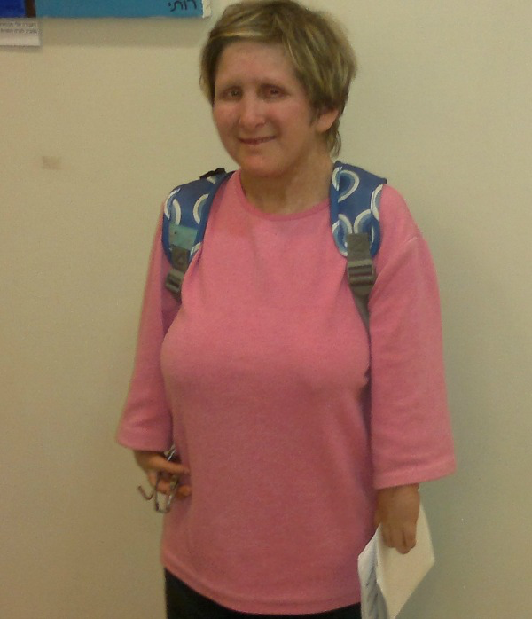
Fanconi’s anemia
Notes:
Fanconi’s anemia associated with shortened stature among other phenotypic manifestations. It is an inherited defect in DNA repair leading to nonhomologous end joining

Slide 17
Dyskeratosis congenita
Abnormal skin pigmentation
Nail dystrophy
Bone marrow failure
Leucoplakia
Learning difficulties
Developmental delay
Mental retardation
Pulmonary disease
Short stature
Extensive dental caries/loss
Oesophageal stricture
Premature hair loss
Malignancy
Intrauterine growth retardation
Liver disease/peptic ulceration/enteropathy
Ataxia/cerebellar hypoplasia
Hypogonadism/undescended testes
Microcephaly
Urethral stricture/phimosis
Osteoporosis/aseptic necrosis/scoliosis
Deafness

Slide 18
Dyskeratosis congenita
Abnormal skin pigmentation
Nail dystrophy
Bone marrow failure
> 80-90 % up to age 30
Leucoplakia
Learning difficulties
Developmental delay
mental retardation
Pulmonary disease
Short stature
Extensive dental caries/loss
Oesophageal stricture
Premature hair loss
Malignancy
Intrauterine growth retardation
Liver disease/peptic ulceration/enteropathy
Ataxia/cerebellar hypoplasia
Hypogonadism/undescended testes
Microcephaly
Urethral stricture/phimosis
Osteoporosis/aseptic necrosis/scoliosis
Deafness

Slide 19
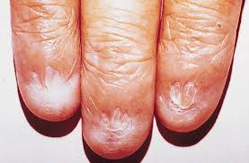
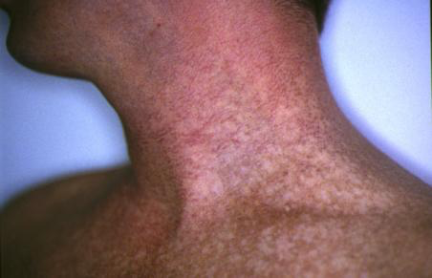
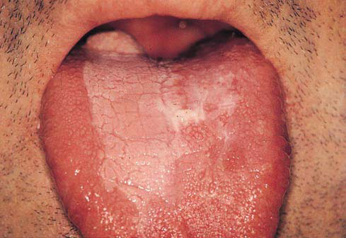
Dyskeratosis Congentia
Notes:
Dyskeratosis Congentia -- reticular hyperpigmentation, nail dystrophy, and leukoplakia. Caused by shortened telomeres as a result of defective telomere maintenance

Slide 20
Dyskeratosis Congentia
DC arises principally from an abnormality in
telomerase activity
A predisposition principally to chromosomal rearrangements rather than the gaps and breaks seen in FA
BM failure is likely to be a consequence of abnormalities in both haemopoietic stem cells and stromal cells

Slide 21
DC genetic subtypes
X-linked recessive 40% (Xq2)
Autosomal dominant 5% (3q21–3q28)
Autosomal recessive 50 %

Slide 22
Shwachman–Diamond syndrome
Exocrine pancreatic insufficiency (100%),
Bone marrow dysfunction (100%) and
Other somatic abnormalities (particularly involving the skeletal system)
SDS gene (SBDS) on 7q11
important role in RNA metabolism and/or ribosome biogenesis.

Slide 23
Shwachman–Diamond syndrome
Short stature (~70%),
Ichthyotic skin rash (~60%).
Metaphyseal dysostosis ~75%
Other abnormalities include
hepatomegaly,
rib/thoracic cage abnormalities,
syndactyly, cleft palate, dental dysplasia,
ptosis and skin pigmentation.

Slide 24
Shwachman–Diamond syndrome
Haematological abnormalities includes neutropenia (~60%), other cytopenias
Approximately 20% have
pancytopenia, myelodysplasia and
leukaemic transformation (~25%)

Slide 25
Classification of AA
II-Acquired AA
Idiopathic
Radiation
Drugs/chemicals
Chloramphenicol
NSAID: (phenylbutasone, indomethacin,gold etc)
Oral hypoglycemic drugs (chlorpropamide,tolbutamide)
Antithyroid drugs, phenothiazines, antimalarials, diuretics,antiepileptics
Antineoplastic and cytotoxic drugs
Pesticides
Solvents and glues: benzene,toluene,xylene,naphtalene
Dyes and industrial toxins
Others

Slide 26
Classification of AA (continued)
4. Infections
Hepatitis
Epstein-Barr virus
Rubella
Cytomegalovirus
Human immunodeficiency virus
Parvovirus
Brucellosis
Tbc
Toxoplasmosis
5. Paroxysmal nocturnal hemoglobinuria(PNH)
6. Immunologic disorders
SLE, eosinophilic fasciitis
Graft- versus- Host Disease
Hypoimmunoglobulinemia
Thymoma
7. Pregnancy
8. Pancreatic insufficiency

Slide 27
Epidemiology of AA
A disease of the young
Median age: about 25 y
1.5 – 2 /1.000.000-year
Equal sex ratio

Slide 28
Aplastic Anemia: Diagnosis and Grading
Diagnostic criteria
Moderate
Hypocellular Marrow
< 50% cellular marrow
Bilineage cytopenia >6 wks
Absolute neutrophil count (ANC) <1500/μL
Reticulocytes < 60,000/μL
Platelet's < 100,000/μL

Slide 29
Aplastic Anemia: Diagnosis and Grading
Severe
Hypocellular marrow
< 25-30% cellular marrow
< 50% cellular marrow
Bilineage cytopenia (2 of the 3)
Absolute neutrophil count (ANC) <500/μL
Retic <20,000/μL
Plts <20,000/μL
Excluding myelodysplastic syndrome
Very Severe
ANC <200 /μL

Slide 30
Pathophysiology
Defective stroma
Stem cell damage
Damage to stem cell DNA: Radiation, drugs etc
Later progenitor cell damage: Viruses
Immune mediated
Inadequate production of growth factors?

Slide 31
Immune mediated injury
Blood and bone marrow of AA patients supress normal progenitor cell cultures
Cultured AA marrow recovers colony formation after removal of T-cells
Immunosupressive therapy is effective in about half of AA patients
Viruses may cause an infection of the stem cell further leading to an immune response to permanent stem cell failure

Slide 32
Immune-mediated
Chemical/Toxin
Infectious
Aplastic Anemia
PNH
Radiation
Genetic
Idiopathic
Notes:
Heterogeneous disorder

Slide 33
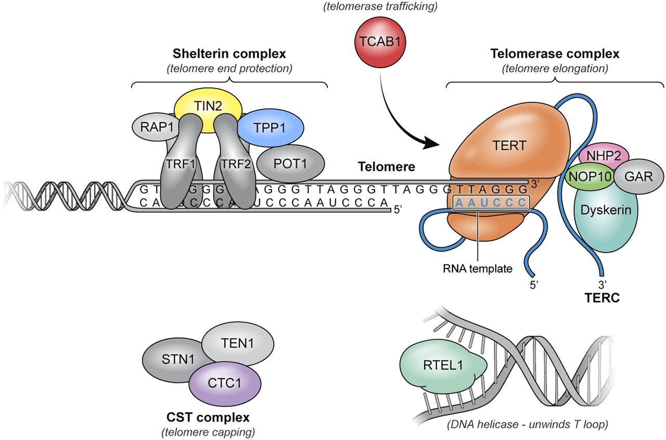
Components of telomere maintenance implicated in human disease.
Townsley D M et al. Blood 2014;124:2775-2783
©2014 by American Society of Hematology
Notes:
Components of telomere maintenance implicated in human disease. Telomeres are composed of thousands of TTAGGG repeats localized at the ends of linear chromosomes. Telomeres are coated by shelterin, a 6-protein complex (TRF1, TRF2, TIN2, POT1, TPP1, and RAP1) with multiple roles in maintaining telomere length homeostasis by forming the T loops, preventing DNA damage response activation, and recruiting the telomerase complex and modulating its activity. The 3′ end of the telomeric leading strand terminates as a single-stranded overhang, which folds back and invades the double-stranded telomeric helix, forming the T loop. Unwinding of the T loop, needed for telomere elongation, is done by a DNA helicase, RTEL1. Telomerase, the enzyme responsible for telomere elongation, has a 4-protein scaffold (dyskerin, NOP10, NHP2, and GAR) and an RNA template (TERC) and reverse transcriptase TERT. TCAB1 ensures trafficking of the telomerase complex to the telomeric ends. The CST complex has multiple proposed roles through its 3 members (CTC1, STN1, and TEN1); CTC1 inhibits telomerase activity and also promotes lagging strand synthesis by binding single stranded DNA and interacting with α polymerase primase. Components in gray have not been implicated in human disease.

Slide 34
True Biological Clock

Slide 35
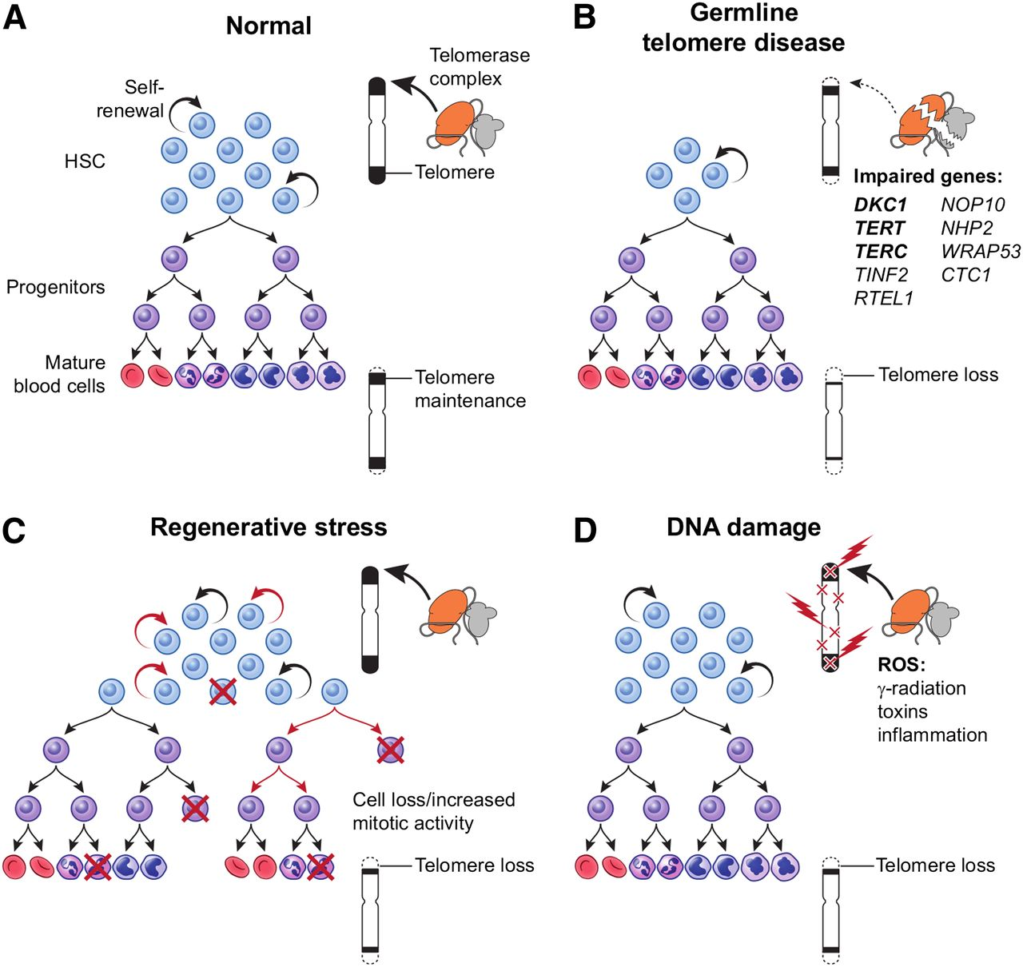
Mechanisms of telomere attrition
©2014 by American Society of Hematology
Townsley D M et al. Blood 2014;124:2775-2783
Notes:
Mechanisms of telomere attrition. (A) Physiological telomere attrition in normal individual hematopoietic cells is the result of balance between telomerase mediated telomere elongation and telomere loss with each cell division. Gradual decrease in mean telomere content occurs with age. (B) Germ-line mutations in a telomere repair gene lead to a reduced stem cell pool and severe telomere loss during replication. (C) Regenerative replicative stress during bone marrow failure, recovery after chemotherapy, or hematopoietic transplant also leads to telomere loss due to increased mitotic activity in stem cells and/or progenitors. (D) Reactive oxygen species (generated from radiation, toxins, and inflammation) cause DNA damage and telomere loss as a direct effect on the telomere. HSC, hematopoietic stem cell.

Slide 36
Mechanisms of telomere attrition
(A) Physiological telomere attrition in normal individual hematopoietic cells is the result of balance between telomerase mediated telomere elongation and telomere loss with each cell division. Gradual decrease in mean telomere content occurs with age.
(B) Germ-line mutations in a telomere repair gene lead to a reduced stem cell pool and severe telomere loss during replication.
(C) Regenerative replicative stress during bone marrow failure, recovery after chemotherapy, or hematopoietic transplant also leads to telomere loss due to increased mitotic activity in stem cells and/or progenitors.
(D) Reactive oxygen species (generated from radiation, toxins, and inflammation) cause DNA damage and telomere loss as a direct effect on the telomere.

Slide 37
Robbins and Cotrans, Chapter 14, Figure 14-24
Notes:
In support of the immune-mediated model is the fact that the residual stems cells in many cases have upregulated genes regulating apoptosis and cell death pathways similar to what is seen in cells exposed to interferon-gamma. Studies have demonstrated clonal expansion of activated T-cells with T-cell receptor gene rearrangements to hematopoietic progenitor cells(?). increase inAdditionally, T-cell suppression using ATGAM, cyclosporin, and steroids is therapeutically beneficial in 60-70% of cases.
On the other-hand is the notion that there is a fundamental intrinsically damaged stem cell. This is supported by karyotypic damage seen in many cases along with the associated increased risk of acute leukemia/MDS, and the association with shortened telomeres. I might add to the right hand side of the figure above, an increased stem cell exhaustion (reduced self-renewal capacity).
These theories are not in themselves mutually exclusive. It is possible that both could be contributing.

Slide 38
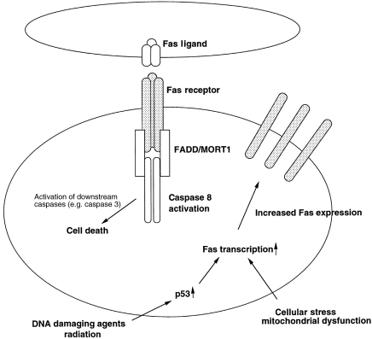
FAS-Ligand Apoptosis Pathway
Desmond R et al. Seminars in Hematology. 2015;52(1):31

Slide 39
In support of the immune-mediated model is the fact that the residual stems cells in many cases have upregulated genes regulating apoptosis and cell death pathways similar to what is seen in cells exposed to interferon-gamma.
Studies have demonstrated clonal expansion of activated T-cells with T-cell receptor gene rearrangements to hematopoietic progenitor cells increase. In additionally, T-cell suppression using ATGAM, cyclosporin, and steroids is therapeutically beneficial in 60 -70% of cases.
On the other-hand is the notion that there is a fundamental intrinsically damaged stem cell. This is supported by karyotypic damage seen in many cases along with the associated increased risk of acute leukemia/MDS, and the association with shortened telomeres. I might add to the right hand side of the figure above, an increased stem cell exhaustion (reduced self-renewal capacity).
These theories are not in themselves mutually exclusive. It is possible that both could be contributing.

Slide 40
Clinical Features of AA
History:
Bleeding
Symptoms of anemia
Infections
Drugs, chemicals or other etiologically important exposures have to be questioned.

Slide 41
Clinical Features of AA
Physical exam:
Petechiae, ecchymosis
Retinal bleeding
Pallor
Fever and other signs of infection
Presence of lymphadenomegaly and /or splenomegaly are unusual (indicate other diagnoses).

Slide 42
Clinical Features of AA
LAB:
Pancytopenia
Reticulocytes: Low or absent
RBC: normochrome-normocytic, or slight macrocytosis
Neutropenia and relative lymphocytosis
Red and white cell precursors are almost never seen in the peripheral smear

Slide 43
Clinical Features of AA LAB:
PNH tests may be positive (Ham’s or sucrose lysis tests, others)
Serum iron is increased
Bone marrow :
Aspiration; Dry tap
Biopsy; all three cell lines are reduced or absent, raplaced by fatty tissue, residual lymphocytes, increased iron stores, rarely hot spots of hematopoesis

Slide 44
Course and prognosis of AA
Definition of severe aplastic anaemia:
1−hypocellular bone marrow
2-neutrophils < 500/mm³
3-platelets < 20.000/mm³
4−reticulocytes < 20.000/mm³ (<%1)
Survival in severe disease is about 1 year if it is treated with transfusions only.
Very severe AA:
Severe AA criteria + Neutrophils: < 200/mm³

Slide 45
Diagnostic Evaluation
Complete Blood Count with reticulocyte count
Liver function tests (LFTs)
B12 and folate
Hep ABC, CMV, EBV, HIV, ParvoB19
Antinuclear antibody (ANA) and ds-DNA
Fetal hemoglobin (Hgb F)
Blood lymphocyte diepoxybutane test (DEB test) for chromosome breakage
Flow for paroxysmal nocturnal hemoglobinuria (PNH)
Bone marrow aspirate and biopsy
Cytogenetics and karyotyping

Slide 46
Diagnostic Evaluation
Chest X-ray and X-rays of appendages
Bone abnormalities or ribs, forearms, hands/feet
High-resolution chest computed tomography and pulmonary function tests (PFTs)
Pulmonary fibrosis
Abdominal ultrasound
SMY may suggest other heme-malignancy
Cirrhosis
Renal abnormalities

Slide 47
Diagnostic Evaluation
Emerging studies
Blood lymphocyte telomere length
Next generation sequencing for inherited BMF syndromes
ex. University of Cincinnati Children’s Hospital
Single nucleotide polymorphism array karyotyping

Slide 48
Management of Aplastic Anemia

Slide 49
Treatment of AA
Treatment alternatives:
Allogeneic bone marrow/stem cell transplantation
Immunosupressive treatment
Androgens
Hematopoietic growth factors
Supportive therapy

Slide 50
Treatment of AA (2)
Stem cell transplantation:
Young patients with severe AA and a HLA matched donor should undergo a stem cell transplantation
(minimally transfused patients have a chance of > 80% survival )
Risks: Graft Versus Host Disease (GVHD), engraftment failure, other

Slide 51
Treatment of AA (3)
Immunosupressive treatment
ATG or ALG (antithymosit or antilymphocytic globulin )
Cyclosporin A
Prednisolone
(50% chance of recovery )
Risks:
Early:infections
Late: MDS, PNH, leukemia, other malignancies,
relapse

Slide 52
Treatment of AA (4)
Supportive treatment
Hemopoetic Growth Factors:
GM-CSF, G-CSF: efficiency ? (limited or not)
Transfusions:
Only when indicated
Exclude family members as transfusion donors
Cellular blood products must be irradiated before transfusions
May cause: Iron overload (Repeated RBC’s), alloimmunization, infection transmission
(eg : HIV,HCV,HBV,CMVetc),
Infections: Preventive care, early diagnosis and treatment

Slide 53
Treatment of aplastic anemia
Supportive care
Antimicrobials for infections
Mouth care
Soft tooth brush
Mouth rinses (salt water or chlorhexidine)
Antimicrobial prophylaxis
Quinolones
Fluconazole vs. itraconazole/posaconazole
During and following ATGAM
Acyclovir vs. valacyclovir
PJP prophylaxis ?

Slide 54
Treatment of aplastic anemia
Supportive care
Transfusions for symptom management
Minimize in SCT candidates to prevent HLA and non-HLA allo-immunization
Thresholds
Platelets <20,000/L with ATGAM
Consider type of product needed
Matched products (Rh, Kell, Platelets)?
Irradiated? – especially during HASCT and ATGAM
CMV negative? – during HSCT
Iron chelation
Desferriozamine
Deferasirox
Caution if still getting cyclosporine due to renal toxicities
Deferiprone
Not recommended if neutropenic

Slide 55
Treatment of aplastic anemia
Allogeneic stem cell transplantation
Younger patients with HLA- matched sibling donors
Patients failing primary immunosuppressive therapy
HLA matched unrelated donor SCT if no MRD available
Immunosuppression: anti-thymocyte globulin + cyclosporine
Younger patients without matched sibling donors and older patients
> 70% response rate

Slide 56
Hematopoietic Stem Cell Transplantation

Slide 57
Age and the National Transplant Registries EBMT Data
Outcomes
No difference age 30-40 years vs. 40-50 years
Preparative Regimen
Age <30 yrs: HD-Cytoxan 200mg/kg + ATGAM
Age 30-50 yrs: Flu + Cy (120mg/kg) + ATGAM
Sureda A et al. BMT. 2015;50:1037

Slide 58
Stem Cell Source
Registry Data from the EBMT
303 European BMT centers
First matched-sibling HSCT for AA 1999-2009
Excluded congenital AA
Excluded non-sibling and mismatched sibling sources
HSCT source (Peripheral Blood or Bone Marrow)
Excluded patients with combined sources
Excluded cords
Bacigalupo A et al. Haematologica. 2012;97:1142

Slide 59
Unrelated Donor HSCT
Population
Pediatrics age 0-19
Nine BMT centers in the UK
Comparison with the data from the EBMT registry
Bacigalupo A et al. BJH. 2015;171(4):585

Slide 60
Unrelated Donor HSCT
 | MUD | Sib | IST | MUD-2nd
2-yr OS | 96+/-4% | 91+/-3% | 94+/-3% | 74+/-9%
 |  |  |  | P=0.02
2-yr EFS | 92+/-5% | 87+/-4% | 40+/-7% | 74+/-9%
 |  |  | P=0.0001 | P=0.02
Bacigalupo A et al. BJH. 2015;171(4):585

Slide 61
BMT in Aplastic Anemia
Preferred first-line therapy for
Pts <40-50 yrs age with matched sibling donor
Preparative Regimen
ATAGM + Cyclophosphamide (dose age-dependent)
Bone Marrow source superior
Less graft vs. host disease (acute and chronic)
Superior OS
Regardless of patient age
Timing ASAP
<110 days from diagnosis superior OS

Slide 62
Immunosuppressive Therapy

Slide 63
Why ATGAM?
Allo-HSCT experience
Observed some individuals with graft failure were having auto-recovery of hematopoiesis
ATGAM was part of the preparative regimen of the observed patients

Slide 64
ATGAM, Steroids +/- Cyclosporine
Population
Severe AA any age
without a matched sibling if <45 years
Moderate AA any age with severe unicytopenia
Excluding
PNH by Ham’s test and Fanconi’s Anemia
Prior IST within the last 3 months
only 1 each arm with prior ATGAM
Frickhofen N et al. NEJM.1991;324:1297.

Slide 65
ATGAM+/- Cyclosporine
Response Rates (controls vs. CSA)
At 3 months 39% vs. 65% (p<0.03)
CR 12.2% vs. 9.3%
PR 26.8% vs. 55.8%
At 6 months 46% vs. 70% (p<0.05)
CR 14.6% vs. 25.6%
PR 31.7% vs. 44.2%
Responses at both 3 and 6 months favored the
addition of CSA
Frickhofen N et al. NEJM.1991;324:1297.

Slide 66
Cyclosporine +/- ATGAM
Population
Non-severe AA
requiring platelet or RBC transfusion support
No prior IST
Randomization was a bit unbalanced
Median age and platelet count
Regimen
CSA 5 mg/kg/day po divided into bid dosing x 6mo
Goal trough 75-200
Continue after 6 mo if responding and no plateau
+/- horse ATGAM 15 mg/kg/day IV x 5 days
Marsh et al. 1999
Notes:
Randomization was a bit unbalanced with the combined arm being significantly younger (29 years vs. 35 years median age, p=0.04) with lower median platelets count (15k vs 2k).

Slide 67
Cyclosporine +/- ATGAM
AT 6 months
Response rates (CSA vs. CSA+ATGAM)
ORR 46% vs. 74% (p=0.02)
CR 23% vs. 57%
PR 23% vs. 17%
Median Hgb 9.7 g/dL vs. 11.8 g/dL (p=0.03)
Median Plts 29x10⁹/L vs. 84x10⁹/L (p=0.005)
2nd line therapy given 25% vs. 6% (p=0.005)
Responses at 6 months favored the addition of
ATGAM to cyclosporine
Marsh et al. 1999

Slide 68
Cyclosporine +/- ATGAM
No difference in overall survival
93% vs. 91% (p=0.5)
PFS at 4 years
51% vs. 80% (p=0.0005)
Though no overall survival difference, those
receiving ATAGM less likely to to progress and
need second line therapy
Marsh et al. 1999

Slide 69
Role of G-CSF or Erythropoietin
No difference in hematopoietic response rate
Tichelli A et al. Blood 2011;117(17):4434
Gurion R et al. Haematologica. 2009;94(5):712

Slide 70
Immunosuppressive Therapy (IST); The Nature of the Beast
Why was this looked examined?
rATG > hATGAM for preventing renal allograft rejection
rATG more effectively depleted lymphocytes and was more cytotoxic on weight basis
rATG was able to elicit responses in patients with SAA refractory-relapsed after hATGAM
rATG (not hATGAM) induces T-reg development in tissue cultures

Slide 71
Immunosuppressive Therapy (IST); The Nature of the Beast
Population
Age >2 years with SAA
RCT with 1:1 distribution
Primary Endpoint
Response rate at 6 months
Regimen
hATGAM 40 mg/kg/day x 4 days
rATG 3.5 mg/kg/day x 5 days
Both arms:
CSA 10 mg/kg/day divided into bid dosing (adult dose) x 6 months
trough goal 200-400 mg/mL
Scheinberg, P et al. NEJM 2011;365(5):430

Slide 72
Immunosuppressive Therapy (IST); The Nature of the Beast
Response Rates
At 3 months (p=0.002)
hATGAM 62%
rATG 33%
At 6 months (p<0.001)
hATGAM 68%
rATG 37%
Scheinberg, P et al. NEJM 2011;365(5):430

Slide 73
Immunosuppressive Therapy (IST); The Nature of the Beast
OS 96% vs. 76% (p=0.04) favoring hATGAM
No difference in clonal evolution
rATG resulted in more prolonged lymphopenia with especially profound CD4+ depletion
Scheinberg, P et al. NEJM 2011;365(5):430

Slide 74
Treating the Elderly Patient
Co-morbidities
Inferior tolerance of ATGAM
Higher rates of infection and bleeding
Higher rates of heart failure and arrhythmias
Considerations
Toxicity
Speed of needed response
Very severe disease
Severe or recurrent infections requiring hospitalization

Slide 75
Treating the Elderly Patient
ATGAM + Cyclosporine
Cyclosporine
Lower RR but no difference in OS
With the combining with 2nd line therapies
Careful with HTN and renal disease
Alemtuzumab
Androgens (Danazol)
Women may not tolerate

Slide 76
ATGAM Adminstration
40 mg/kg/day IV over 12-18 hours x 4 days
Test dose on day one
Premedications
Prednisolone 1 mg/kg/day x 2 wks then taper over 2 wks
Benadryl
Platelets prophylactically to keep >20 x10⁹/L
Antimicrobial Prophylaxis
Levaquin, Antifungal, Acyclovir
Monitor and maintain fluid balance
Prone to volume retention with therapy
Hydrocortisone IV every 6 hrs prn serum sickness
Usually occurs days 7-14
Avoid vaccinations (?)

Slide 77
Predictors of Response
Younger age
Less severe disease
Retic count >25x10⁹/L
ALC > 1x10⁹/L
Cytogenetics with trisomy 8 or del(13q)
PNH clone?

Slide 78
Managing Relapsed-Refractory Disease

Slide 79
IST-Refractory Aplastic Anemia
Why might a patient fail first line immunosuppressive therapy IST
Failure to ablate the auto-reactive T-cells
30-40% of cases failing hATGAM will respond to alternative IST
Non-immune mechanism of marrow failure

Slide 80
Management Options
If transplant eligible patient <40-50 years
Consider for MUD donor HSCT
If not, consider alternative donors on study
If transplant eligible patient 50-60 years
Consider allo-HSCT versus alternatives
If transplant ineligible any age
Second line IST
Horse vs. rabbitt ATG
Alemtuzumab
Thrombopoietin mimetic

Slide 81
Relapses After First-Line IST
Overall ~1/3 of patients relapse after ATGAM
Responses to 2nd-line IST (horse or rabbit)
35% in refractory cases
55-60% in relapsed cases

Slide 82
Alemtuzumab
Response rates typical of relapsed-refractory patients with other second-line IST
35% in refractory cases
55% in relapsed cases

Slide 83
Alemtuzumab
100 mg total dose over 4 days
10 mg SQ on day 1
30 mg SQ on days 2-4
Requires PJP prophylaxis
Monitor for CMV reactivation

Slide 84
Alemtuzumab
Consider if not eligible for a HSCT and
Re-treatment with ATGAM not an option
Renal impairment
Do not need the CSA

Slide 85
Thrombopoietin Stimulation Therapy

Slide 86
Thrombopoietin
Synthesized primarily in the liver
Also by bone marrow stroma cells
Possible paracrine functions?
Body regulates the platelet pool mass
Not regulating platelet numbers
TPO serum levels increased in aplastic anemia
So what would be the rationale behind TPO stimulation in aplastic anemia?

Slide 87
TPO Stimulation Rationale
TPO-receptor (aka c-mpl)
expressed on hematopoietic stem cells and progenitor cells
TPO may have a DNA repair role
independent of c-mpl
Congenital absence of TPO or c-mpl
Decreased hematopoietic stem cells & progenitors
Amegakaryocytic thrombocytopenia
Progress to pancytopenia with reduced marrow cellularity

Slide 88
Eltrombopag
Synthetic, non-peptide TPO mimetic
Small molecule
Better kinetics for entering the BM niche?
Binding to c-mpl
At juxtramembrane and transmembrane domains
NOT at TPO-binding domain
Does NOT compete with TPO for binding
Perhaps alternative signal transduction cascade via dual activation?

Slide 89
Eltrombopag in Aplastic Anemia
Population
Prior IST for Severe Aplastic Anemia (median 2 priors)
Platelets <30,000/mcl
Dose escalation
Started 50 mg po daily
Increased 25 mg daily every 2 weeks up to150 mg
Primary endpoint
hematopoietic response rate at 3-4 months*
17/43 patients (40%)
7/43 (16%) patients with trilineage response
6/43 had drug withdrawn with sustained normocellular response at 24 months.
Olnes MJ. NEJM 2012;167(1):11
Desmond R. Blood 2014;123(12):1818
*currently using 6 months in next study

Slide 90
Clonal Evolution on Eltrombopag
8/43 patients
6 non-responders and 3 responders
Chromosome 7 most commonly involved (5 of 8)
Chromosome 13q deletion seen in 2 responders
None developed acute leukemia
though 5 underwent allo-HSCT for the AA
Why? Unknown
Stimulation of dormant clones?
Not noted to be so in CGH-SNP comparisons pre-post specimens
Stimulation driven proliferation leading to …
genomic destabilization?
accelerated telomere attrition?

Slide 91
Severe Aplastic Anemia and Clonal Progression
15% MDS/AML progression within 10 years of diagnosis
Increased association with IST-refractory disease
Unknown if increased with use of TPO-stimulation therapy
10% Hemolytic PNH

Slide 92
Future Directions
IST plus TPO-stimulation as 1st line therapy
Cyclosporin plus TPO-stimulation
Role of TPO stimulation for moderate-AA or unicytopenic patients

Slide 93
Thank you

